Slide 1
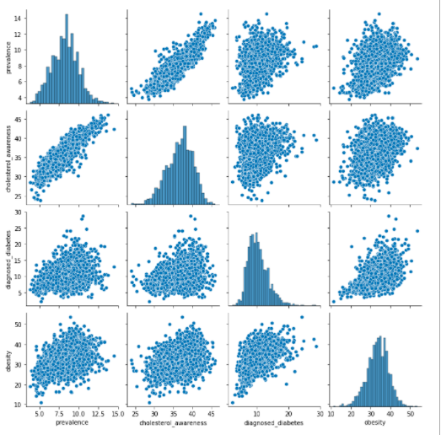
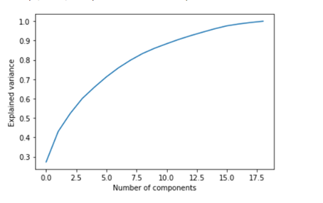
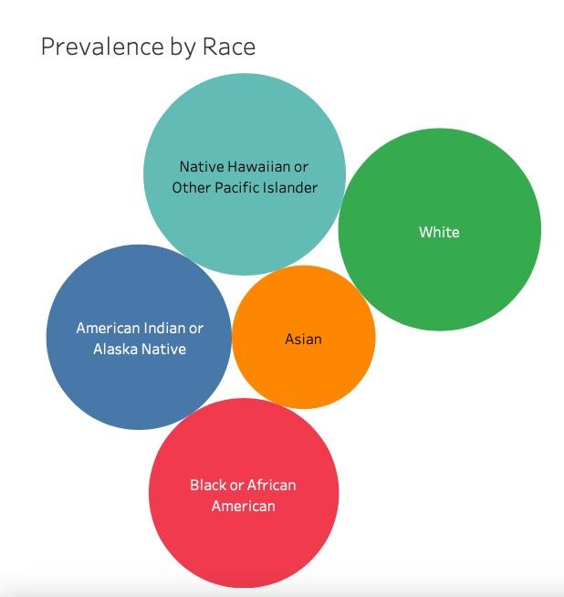
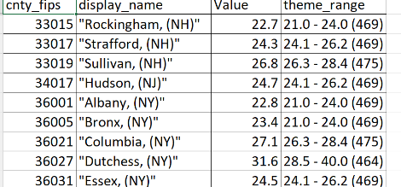


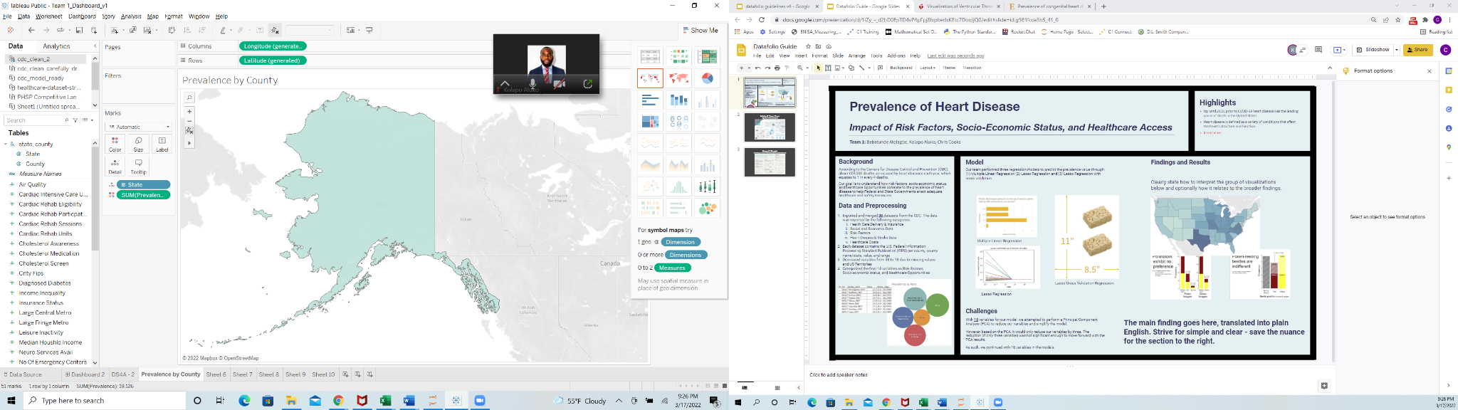
Prevalence of Heart Disease in U.S. Counties
Impact of Risk Factors, Socio-Economic Status, and Healthcare Access
Highlights
Up until 2020, prior to COVID-19 heart disease was the leading cause of death in the United States.
Heart disease is defined as a variety of conditions that affect the heart’s structure and function, such as Coronary Artery Disease (CAD) and Heart Failure.
Team 1: Babatunde Atolagbe, Kolapo Aluko, Chris Cooks
Background
According to the Centers for Disease Control and Prevention (CDC), about 659,000 deaths are caused by heart diseases each year, which equates to 1 in every 4 deaths.
Our goal is to understand how risk factors, socio-economic status, and healthcare opportunities correlate to the prevalence of heart disease to help Federal and State Governments enact adequate healthcare and safety measures.
Model
Findings and Results
Our team performed four models (one Principal Component Analysis & three regressions) to determine key predictors with the most impact on prevalence through: (1) Exploratory Linear Regression (2) Lasso Regression and (3) Lasso Regression with cross validation.
Using the R-Squared metric to measure variance, we found that the Lasso Regression was the most efficient model. By using the Lasso Regression, we can predict prevalence by an error of 0.432%
Recommend Insert Graphic here
Model | R-Squared | Test Error (% Prevalence)
Principal Component Analysis | 88.89 | 0.501
Exploratory Linear Regression | 91.73 | 0.439
Lasso Regression | 91.99 | 0.432
Lasso Cross Validation Regression | 91.93 | 0.434
Data and Preprocessing
Exported and merged 38 datasets from the CDC. The data was exported by the following categories:
Health Care Delivery & Insurance
Social and Economic Data
Risk Factors
Heart Disease & Stroke Data
Healthcare Costs
Each dataset contains the U.S. Federal Information Processing Standard Publication (FIPS) per county, county name/state, value, and range
Decreased variables from 38 to 18 due to missing values and US Territories
Categorized the final 18 variables as Risk Factors, Socio-economic status, and Healthcare Opportunities
Exploratory Linear Regression - Four predictors removed due to high P-values (>0.05)
Principal Component Analysis - Only a decrease of six predictors to capture 90% variance.
Our findings show the south and midwest regions have a high level of prevalence of heart disease, and where the impact of risk factors, socio-economic status, and healthcare opportunities combined are largest by state.
Lasso Regression - Penalized 12 insignificant predictors
From the original 38 factors, 8 factors have been identified as key contributors to Heart Disease Prevalence. The 8 factors are cholesterol awareness, physical inactivity, smoking, cardiac rehab participation, cholesterol medication, age 65+, poverty, and urban classification

